Slide 1
Class 3.4 – Views and thymeleaf
Class 3.4 – 12/13/18
Instructor: Hank dedona

Slide 2
Class 3.3 – Recap
We talked about controllers and routes
@RequestMapping(value = “path”, method = RequestMethod.GET)
@ResponseBody – For returning values as HTTP bodies

Slide 3
Gradle depencies
dependencies { implementation('org.springframework.boot:spring-boot-starter-thymeleaf') implementation('org.springframework.boot:spring-boot-starter-web') runtimeOnly('org.springframework.boot:spring-boot-devtools') testImplementation('org.springframework.boot:spring-boot-starter-test') }

Slide 4
Thyme Templates
All thyme templates are based on HTML files and have .html file suffixes.
By default, templates are stored in src/main/resource/templates
If you use the default template directory, then you only need to return the name of the template in your controller, if it’s in a sub-directory then the subdirectory must be included. (e.g. ”cheese/index”)

Slide 5
First thymeleaf template
In order to use Thymeleaf in your HTML templates, you must add the XML namespace to the HTML tag
<html lang="en" xmlns:th="http://www.thymeleaf.org/">
After that, you can use thymeleaf as such: th:text, etc
Variables are denoted in thymeleaf templates using “${variable_name}”
E.g. <title th:text="${title}" />

Slide 6
Spring Controller model usage
In order to pass in variables to the Thymeleaf template, you have to denote the model in the controller and add attributes (in key/value pairs)
public String index(Model model) {
model.addAttribute("title", "My Cheeses");
}
Then you can access that variable in your template as such ”${title}” will be replaced with “My Cheeses”

Slide 7
Thymeleaf templates - loops
The th:each loop is similar to the for-each loop. This will create an li (list item) element for each item in the cheeses model (which is a list)
<li th:each="cheese : ${cheeses}" th:text="${cheese}"></li>
This will create a new list item (li tag) for each item in the list (array) cheeses and set the value to cheese and then set the text to cheese

Slide 8
Thymeleaf if’s
If’s (or if not’s in this case) in Thymeleaf is the th:unless tag
<p th:unless="${cheeses} and ${cheeses.size()}">no cheese :(</p>
What this says is if not the key of cheeses is passed in, display this tag.
You can also call methods on the objects passed in (e.g. cheeses.size() )

Slide 9
Spring requestParam’s
We can access the request parameters in Spring two ways
1) Use the HttpServletRequest and call request.getParamter(“key”);
2) Use the @RequestParam annotation
The @RequestParam annotation is much more widely used
E.g. public String processAddCheeseForm(@RequestParam String cheeseName)
Note: The variable name (cheeseName in this example) must match the key of your form, query param, etc.

Slide 10
Reusable Intellj templates
Using reusable IntellJ templates prevent duplicate code and copy/paste.
For example, not having to add the XML namespace for Thymeleaf everytime you create a new HTML file.
Right click on project -> new -> edit file templates -> +

Slide 11
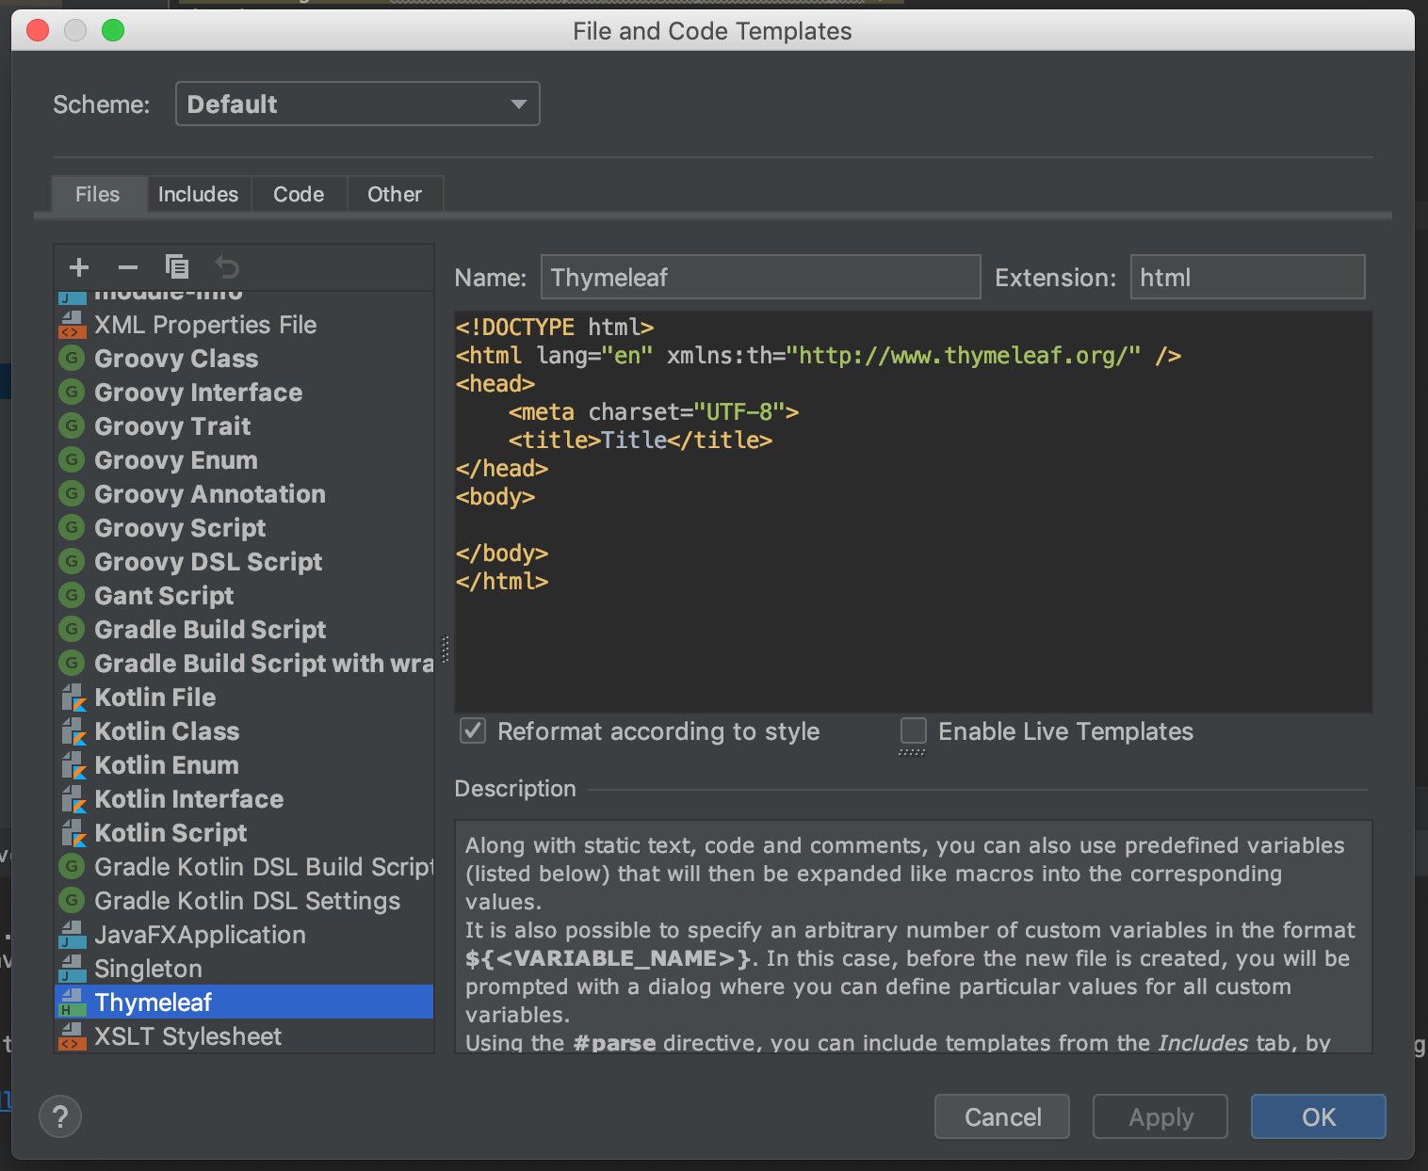
New file template

Slide 12
Thymeleaf Fragements
Thymeleaf fragments allow you to create code “snippets” that can be shared among your Thymeleaf template HTML files. Note: This can only be for a single HTML element!
<head th:fragment="head"> <meta charset="UTF-8"> <title th:text="${title}">My Default Cheeses Title</title> </head>
This allows any other template to use this fragment using the following tag
th:replace=“fragments :: head”
Replace this entire element with the code in the fragments.html file called head
Template fragments allow you to make changes in one place instead of multiple files!

Slide 13
static Resources (css/js)
Static content like CSS and JS files (by convention) should be stored in the src/main/resources/static directory
In order to include them into your Thymeleaf templates, you must tell Thymeleaf where to find them.
Examples:
CSS: <link rel="stylesheet" th:href="@{/css/styles.css}" />
JS: <script type="text/javascript" th:src="@{/js/script.js"} />

Slide 14
Next…
Don’t forget about the Thymeleaf cheatsheet!
https://github.com/LaunchCodeEducation/cheatsheets/blob/master/thymeleaf/README.md
Studio: Cheese MVC
https://education.launchcode.org/skills-back-end-java/studios/cheese-mvc/
Also, don’t forget that the TechJobs (Console Edition) is due today!!!!

